Slide 1
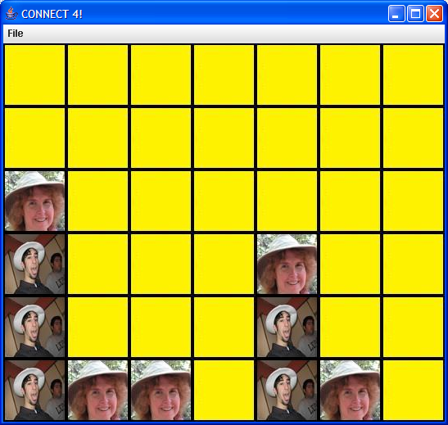
CONNECT 4
By: Milkias Tadesse, Samir Harb, Brian Petzinger

Slide 2
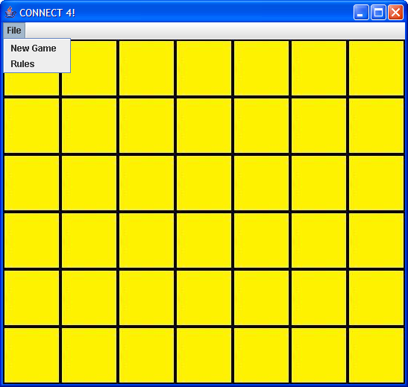


design
Creates the game board using 2-D array
Checks Win based on rules of the game
COMPUTER
PLAYER

Slide 3
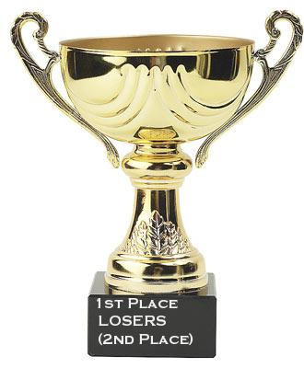
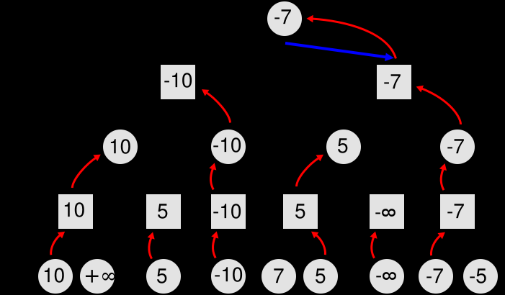

implementation
Minimax and alpha-beta pruning
Heuristic
+
=

Slide 4
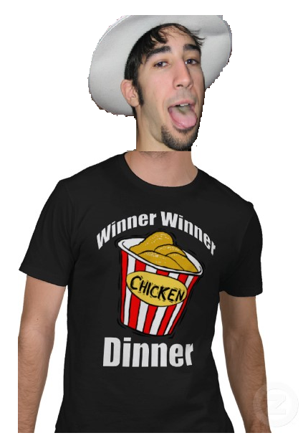
conclusion

